Slide 1
HEART DISEASE PREDICTION
PRESENTED BY:- RAJ KUMAR
BATCH-81

Slide 2
PROBLEM
The dataset provides the patients' information.
This dataset is based on cardiovascular study on residents of the town of Framingham, Massachusetts.
We have to build a model to predict for risk in future for coronary heart disease(CHD).

Slide 3
DATA DESCRIPTION
Demographic
Sex: male or female
Age: Age of the patient
Behavioral
Current Smoker: whether or not the patient is a current smoker(0 means No,1 means-Yes)
Cigs Per Day: the number of cigarettes that the person smoked on average in
one day.

Slide 4
DATA DESCRIPTION
Medical( history)
BP Meds: whether patient was on blood pressure medication(0 means No,1 means-Yes)
Prevalent Stroke: whether patient had previously had a stroke(0 means No,1 means-Yes)
Prevalent Hyp: whether or not the patient was hypertensive(0 means No,1 means-Yes)
Diabetes: whether or not the patient had diabetes(0 means No,1 means-Yes)
Tot Chol: total cholesterol level
Sys BP: systolic blood pressure
Dia BP: diastolic blood pressure
BMI: Body Mass Index
Heart Rate: heart rate
Glucose: glucose level
desired target :- (10 year risk of coronary heart disease CHD (binary: “1”, means “Yes”, “0” means “No”)

Slide 5
DATA DESCRIPTION
Dataset contains 4238 rows and 15 columns
Dataset contains 6 int type columns.
Dataset contains 8 float type columns.
Dataset contain 1 object type column.

Slide 6
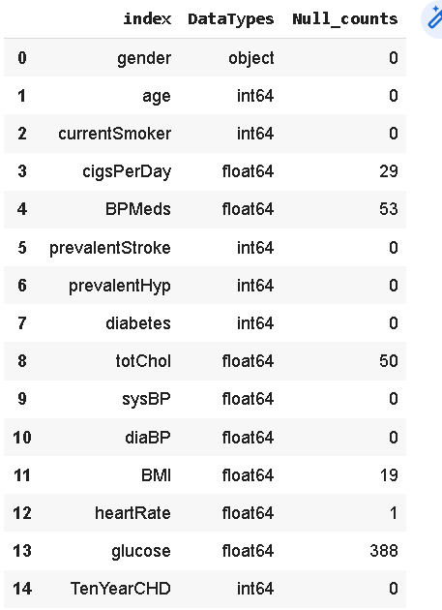
EXPLORATORY DATA ANALYSIS
The dataset consist of 15 columns.
There are 6 integer type, 8 float type and 1 object type data.
We need to check null counts in all column index.
Checking null values in all columns
pd.DataFrame({"index":data.dtypes.index,
"DataTypes":data.dtypes.values,
"Null_counts":data.isnull().sum().values})
Observation:- There are 6 columns need data imputation to get desirable result.

Slide 7
NULL IMPUTATION
Null imputation in all columns having null values.
data["cigsPerDay"].fillna(data["cigsPerDay"].mean(),inplace=True)
data["BPMeds"].fillna(data["BPMeds"].mode()[0],inplace=True)
data["totChol"].fillna(data["totChol"].mean(),inplace=True)
data["BMI"].fillna(data["BMI"].mean(),inplace=True)
data["heartRate"].fillna(data["heartRate"].mean(),inplace=True)
data["glucose"].fillna(data["glucose"].mean(),inplace=True)

Slide 8
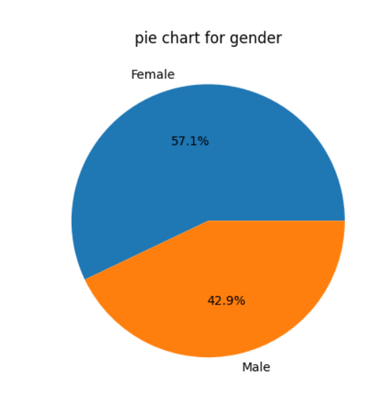
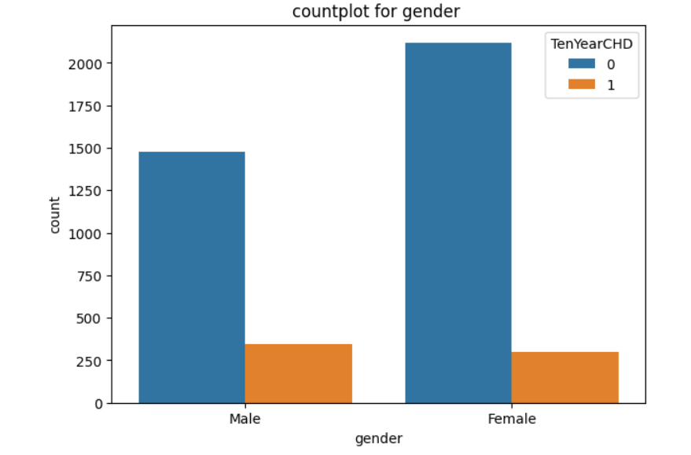
INSIGHTS FROM EDA
there are 57% females and 43% mans.
It is observed that males has more chances to be suffered by heart disease in future.

Slide 9
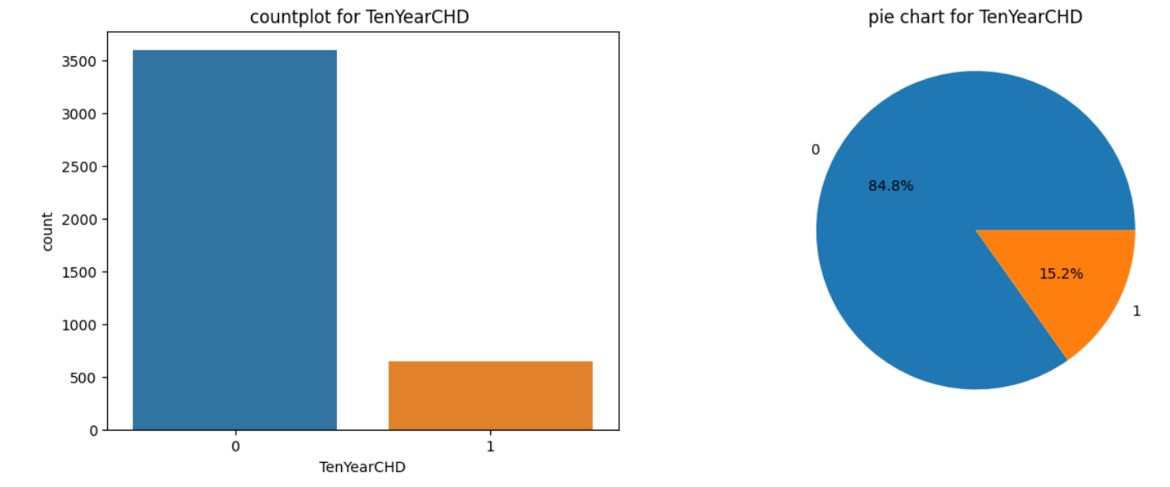
INSIGHTS FROM EDA
Based on sample dataset almost 15% data points have chances to suffered from Heart disease in next 10 years.

Slide 10
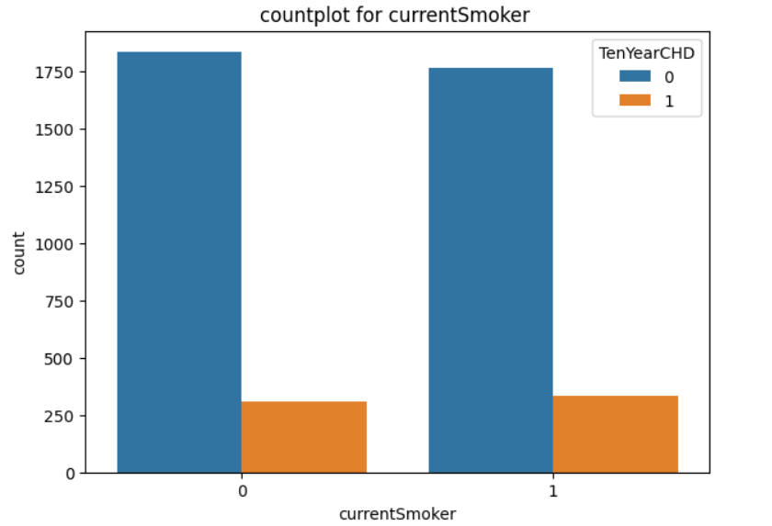
INSIGHTS FROM EDA
There is not much effect of smoking in heart disease as non smoker and smoker both have same chances of suffering from disease.

Slide 11
FEATURE ENCODING
#imporing labelencoder from sklearn
from sklearn.preprocessing import LabelEncoder
#assigning labelencoder to encoder
encoder=LabelEncoder()
#labelling of "gender" by using labelencoder
data2["gender"]=encoder.fit_transform(data2["gender"])
What is Feature Encoding?
Feature Encoding converts object type variables to numerical variables as part of the feature engineering , step to make the data compatible with Machine Learning models.

Slide 12
TRAIN AND TEST DATA
We need to prepare data for test and training of model.
We will use standard test and train split as 20-80 format.
#importing train test split from sklearn.model_selection
from sklearn.model_selection import train_test_split
x=data2.drop(["TenYearCHD"],axis=1) #except for "TenYearCHD" all other features are input
y=data2["TenYearCHD"] #TenYearCHD is prediction feature
#defining training and test data, test size=0.2 means test data will be 20%.
x_train,x_test,y_train,y_test=train_test_split(x,y,test_size=0.2)

Slide 13
SCALING TRAIN AND TEST DATA
StandardScaler performs the task of Standardization. Usually a dataset contains variables that are different in scale.
If columns are different in scale, they should Standardized to have common scale while building machine learning model.
#importing standard scaler to scale features
from sklearn.preprocessing import StandardScaler
scale=StandardScaler()
x_train=scale.fit_transform(x_train) #scaling training data by standard scaler
x_test=scale.transform(x_test) #transforming scale into test data

Slide 14
MODEL TRAINING AND PREDICTION
We will do logistic regression modeling using scikit learn.
#importing logistic regression to create a model
from sklearn.linear_model import LogisticRegression
model=LogisticRegression()
#Giving training to model by training data
model.fit(x_train,y_train)
MODEL PREDICTION
#predicting results on test data
y_pred=model.predict(x_test)

Slide 15
CLASSIFICATION MODEL KPIs
We will use different KPIs to measure model performance.
#importing confusion_matrix,classificatio_report and accuracy_report from metrics to check model performance
from sklearn.metrics import confusion_matrix,classification_report,accuracy_score
class_report=classification_report(y_test,y_pred) #to get classification report
acc_scr_test=accuracy_score(y_test,y_pred)*100 #to get accuracty_score
con_matrix=confusion_matrix(y_test,y_pred) #to get confusion_matrix

Slide 16
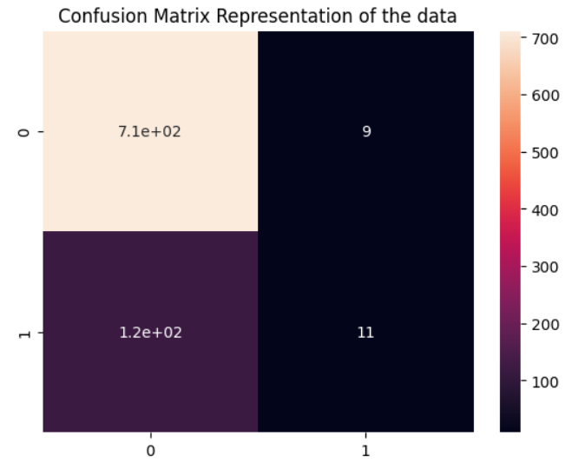
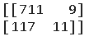
CONFUSION MATRIX
#confusion matrix
print("confusion_matrix for test data is\n",con_matrix)
TP
FN
FP
TN

Slide 17
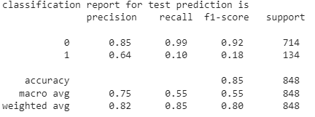
CLASSIFICATION REPORT
#classification report
print("classification report for test prediction is \n",class_report)

Slide 18
ACCURACY SCORE (TEST DATA)
#accuracy score
print(f"accuracy score for test data is {acc_scr_test} %")
ACCURACY SCORE (TEST DATA)
accuracy score for test data is 85.14150943396226 %

Slide 19
PREDICTIONS ON TRAIN DATA
#predicting results on test data
y_pred_train=model.predict(x_train)
#to check accuracy score on training data
from sklearn.metrics import accuracy_score
acc_scr_train=accuracy_score(y_train,y_pred_train)*100
print(f"accuracy score for train data is {acc_scr_train}%")
ACCURACY SCORE (TRAIN DATA)
accuracy score for train data is 85.72271386430678%

Slide 20
LOSS IN MODEL
The training loss indicates how well the model is fitting the training data.
The test loss indicates how well the model fits new data.
train_loss=100-acc_scr_train
print("train loss is ",train_loss)
test_loss=100-acc_scr_test
print("test loss is ",test_loss)
train loss is 14.277286135693217 test loss is 14.858490566037744

Slide 21
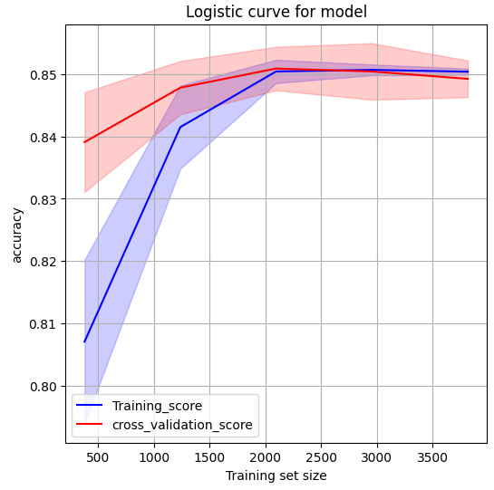
LOGISTIC CURVE FOR MODEL

Slide 22
REGULARIZATION
Regularization refers to techniques that are used to calibrate machine learning models in order to minimize the adjusted loss function and prevent overfitting or underfitting.
The commonly used regularization techniques are : :
Lasso Regularization – L1 Regularization
Ridge Regularization – L2 Regularization
Elastic Net Regularization – L1 and L2 Regularization

Slide 23
REGULARIZATION (with l1)
#model_log_reg_l1
model_log_reg_l1=LogisticRegression(penalty="l1",solver="liblinear") #initialising model with penalty l1
model_log_reg_l1.fit(x_train,y_train) #training model
model_log_reg_l1_prediction=model_log_reg_l1.predict(x_test) #predicting for test data
accuracy_score_reg_l1=accuracy_score(model_log_reg_l1_prediction,y_test)*100 #accuracy score
print("accuracy score with l1 is:",accuracy_score_reg_l1)
accuracy score with l1 is: 85.25943396226415

Slide 24
REGULARIZATION (with l2)
#model_log_reg_l2
model_log_reg_l2=LogisticRegression(penalty="l2") #initialising model with penalty l2
model_log_reg_l2.fit(x_train,y_train) #training model
model_log_reg_l2_prediction=model_log_reg_l2.predict(x_test) #predicting for test data
accuracy_score_reg_l2=accuracy_score(model_log_reg_l2_prediction,y_test)*100 #accuracy score
print("accuracy score with l2 is:",accuracy_score_reg_l2)
accuracy score with l2 is: 85.14150943396226

Slide 25
REGULARIZATION (with ELASTICNET)
#model_log_reg_elastic
model_log_reg_elastic=LogisticRegression(penalty="elasticnet") #initialising model with penalty elastic net
from sklearn.linear_model import ElasticNet
model_log_reg_elastic=ElasticNet()
model_log_reg_elastic.fit(x_train,y_train)
model_log_reg_elastic_prediction=model_log_reg_elastic.predict(x_test)
accuracy_score_reg_elastic=accuracy_score(y_test,model_log_reg_elastic_prediction.round(),normalize=True)*100
print("accuracy score with elasticnet is:",accuracy_score_reg_elastic)
accuracy score with elasticnet is: 84.90566037735849

Slide 26
HYPERPARAMETER TUNING
Hyperparameters in Machine learning are those parameters that are explicitly defined by the user to control the learning process.
There are ideally two approach for the hyperparameter tuning.
GridSearchCV:-
With the gridsearchcv module we fit every hyperparameter that we explicitly specify in the parameter grid and train our model accordingly.
As this approach care of all of the hyperparameters specified hence,it takes more computation time.Accuracy is high with this approach.
RandomSearchCV
With the RandomSearchCV module we fit every hyperparameter that we explicitly specify in the parameter grid at a random and train our model accordingly.
As this approach care of all of the hyperparameters specified at a random hence,it is shown that it takes less computation time.the accuracy with RandomSearchCV is slightly less.

Slide 27
GridSearchCV
TUNING USING GridSearchCV
from sklearn.model_selection import GridSearchCV #importing gridsearchcv
penalty=["l1","l2","elasticnet",None]
solver=["lbfgs","liblinear","newton-cg","newton-cholesky","sag","saga"]
param_grid={"penalty":penalty, "solver":solver,"fit_intercept":[True,False]}
#initializing model
model_grid_search=GridSearchCV(LogisticRegression(),param_grid)
#training to model
model_grid_search.fit(x_train,y_train)
#to get best_fit_parameter
model_grid_search.best_params_
{'fit_intercept': True, 'penalty': None, 'solver': 'lbfgs'}

Slide 28
GridSearchCV
PREDICTION USING HYPERPARAMETERS
#tuning using bestParams
log_reg_grid_tuned=LogisticRegression(fit_intercept=True,penalty='l2',solver="lbfgs")
log_reg_grid_tuned.fit(x_train,y_train)
tuned_prediction_grid=log_reg_grid_tuned.predict(x_test)
Accuracy score
accuracy_scr_grid_tuned=accuracy_score(tuned_prediction_grid,y_test)*100
#accuracy_score of tuned data
print("accuracy score with gridsearch tuned is: ",accuracy_scr_grid_tuned)
accuracy score with gridsearch tuned is: 85.14150943396226

Slide 29
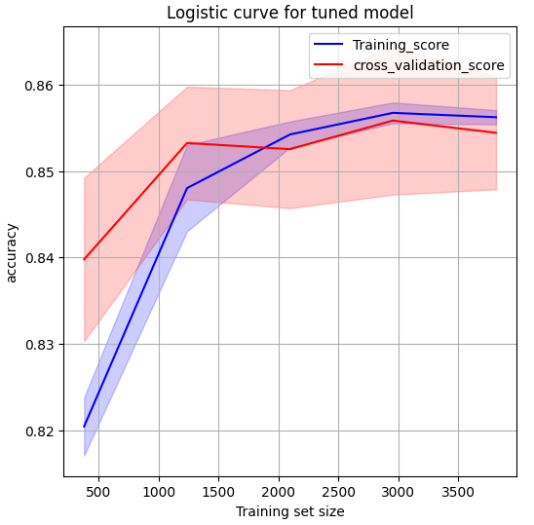
LOGISTIC CURVE AFTER TUNING

Slide 30
RandomSearchCV
TUNING USING RandomSearchCV
from sklearn.model_selection import RandomizedSearchCV #importing RandomizedSearchCV
param_random={"penalty":["l1","l2","elasticnet",None],
"fit_intercept":[True,False]}
model_random_search=RandomizedSearchCV(LogisticRegression(),param_random)
#training to model
model_random_search.fit(x_train,y_train)
##to get best parameters
model_random_search.best_params_
{'fit_intercept': True, 'penalty': None}

Slide 31
RandomSearchCV
PREDICTION USING HYPERPARAMETERS
#tuning using bestParams
log_reg_random_tuned=LogisticRegression(fit_intercept=True,penalty=None)
log_reg_random_tuned.fit(x_train,y_train)
tuned_prediction_random=log_reg_random_tuned.predict(x_test)
Accuracy score
accuracy_scr_random_tuned=accuracy_score(tuned_prediction_random,y_test)*100
#accuracy_score of tuned data
print("accuracy score with randomsearch tuned is: ",accuracy_scr_random_tuned)
accuracy score with randomsearch tuned is: 85.14150943396226

Slide 32
CONCLUSION
Analysis of performance with all the models.
accuracy_all_model=pd.DataFrame({"model_name":["y_prediction_test","y_prediction_train","tuned_gridsearchcv","tuned_randomsearchcv","l1_parameter","l2_parameter","elasticnet_parameter"],
"Accuracy":[acc_scr_test,acc_scr_train,accuracy_scr_grid_tuned,accuracy_scr_random_tuned,accuracy_score_reg_l1,accuracy_score_reg_l2,accuracy_score_reg_elastic]})

Slide 33
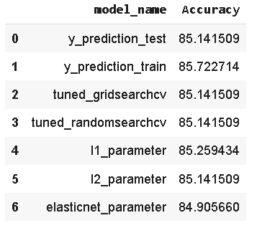
CONCLUSION
It is observed that there are slight differences in models with different parameters.
To obtain more accurate analysis we need to train model with more training data.

Slide 34


